Slide 1
Process Control
Course II
Lecture 3
Measuring element

Slide 2
Closed loop system
m
cp
T_{i}
Temperature measuring element
M
Process
m
cp
T_{o}
Steam in
Q
P
Controller
E
T_{m}
Final control element
Control Valve
Comparator
T_{sp}

Slide 3
Measuring element
Measurement refers to the conversion of the process variable into an analog or digital signal that can be used by the control system. This action can be carried out by two elements: Sensors and transmitter. These two elements together are called Transducer .
Process variable
controller
Sensor
Transmitter
Transducer

Slide 4
Sensor is a device that can detect a physical quantity (such as temperature, pressure,..etc.) and convert the data into an electrical signal.
Transmitter is a device that coverts the signal produced by a sensor into standardized instrumentation signal such as 3-15 psig air pressure or 4-20 mA DC electric current.
Transducer is a device that can convert energy from one form to another
Convertors are such as I/P, P/I, T/I, F/I ….etc.
Measuring variables
1- Temperature
2- Pressure
3- Level
4- Flow
5- Concentration

Slide 5
Air supply
20 psig
Hot water
w (kg/s)
cp
t₁
Convertor
I/P
Controller
Set point
Signal transmitted across the loop
4-20 mA
4-20 mA
3-15 psig
1- Pneumatic 3-15psi
2- Electric 4-20 mA
3- Hydraulic
Temperature transmitter
T/I
oil
m (kg/s)
cp
Ti
oil
m (kg/s)
cp
To
w (kg/s)
cp
t₂

Slide 6
Measuring elements for process control
The five important measurement elements are
1- Flow
2- Temperature
3- Pressure
4- Level
5- Concentration

Slide 7
1- Flow measurement ( volumetric or mass flowrate)
(a). Orifice plate
(b). Venturi meter
(c). Turbine flow meter
(d). Magnetic flow meter

Slide 8
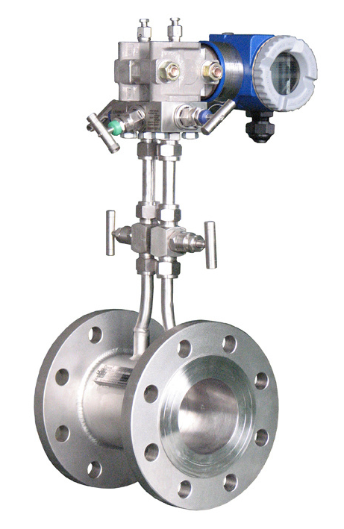
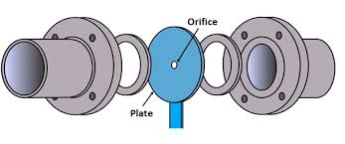
(a). Orifice plate

Slide 9
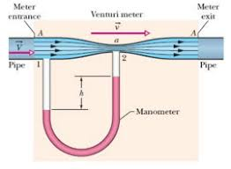
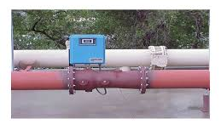
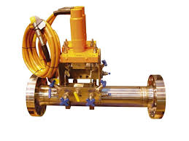
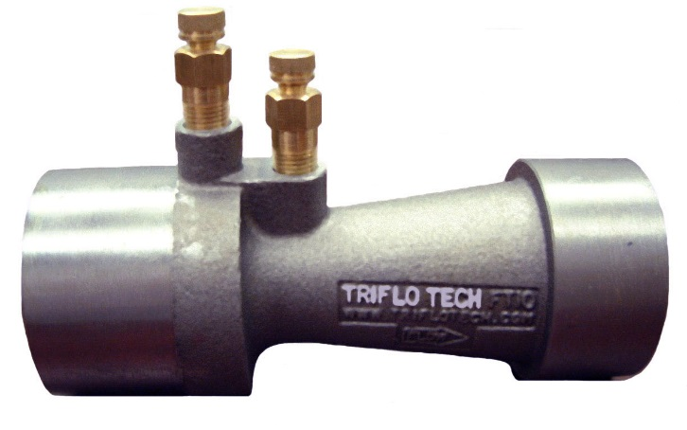
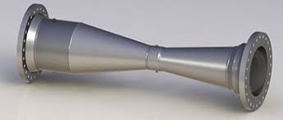
(b). Venturi meter

Slide 10
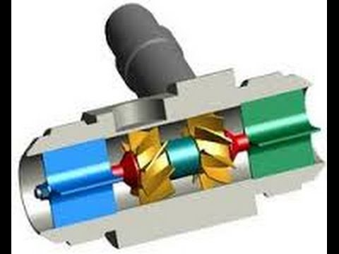
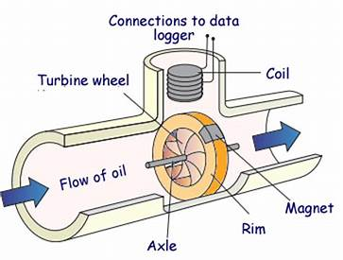
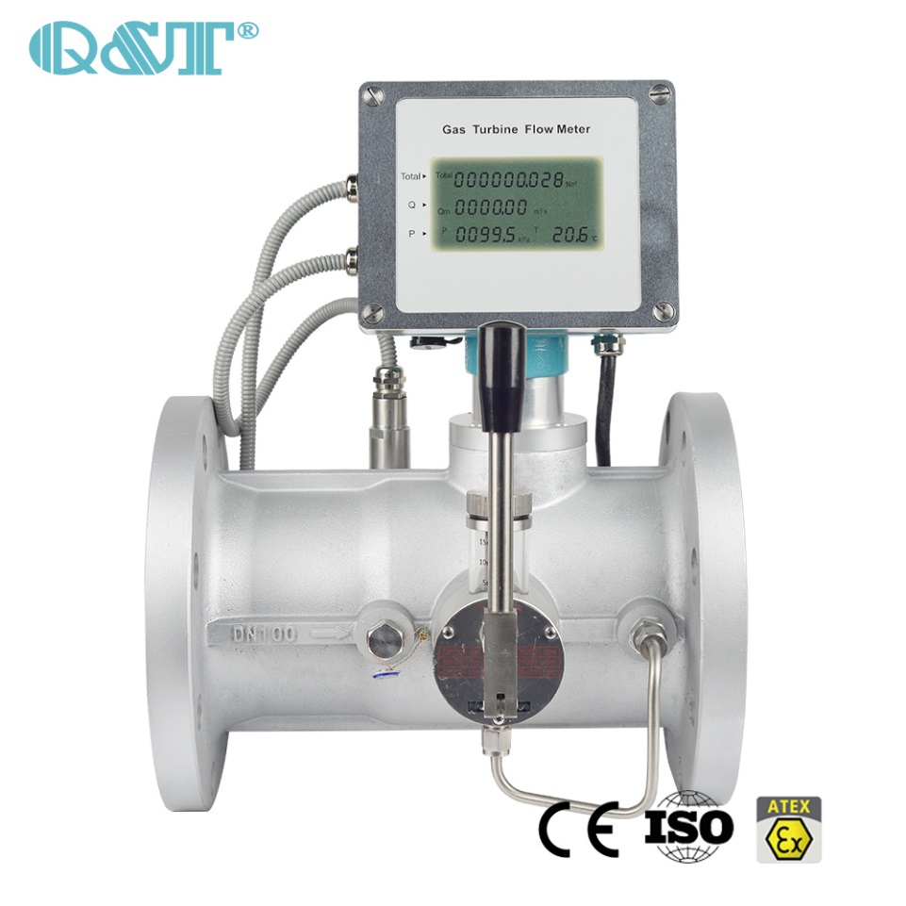
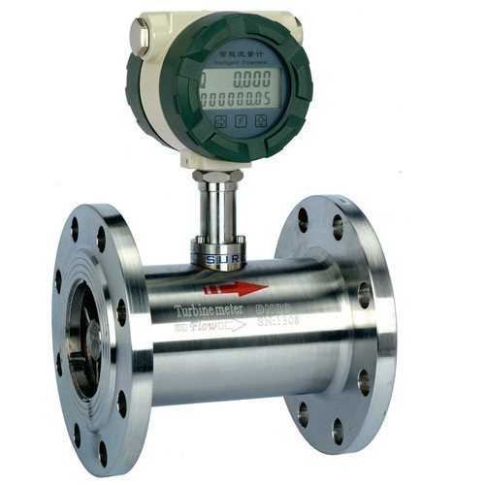
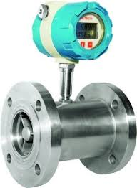
(c). Turbine flow meter

Slide 11
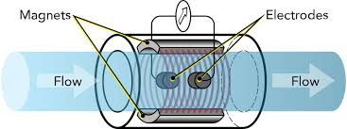
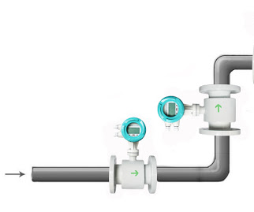
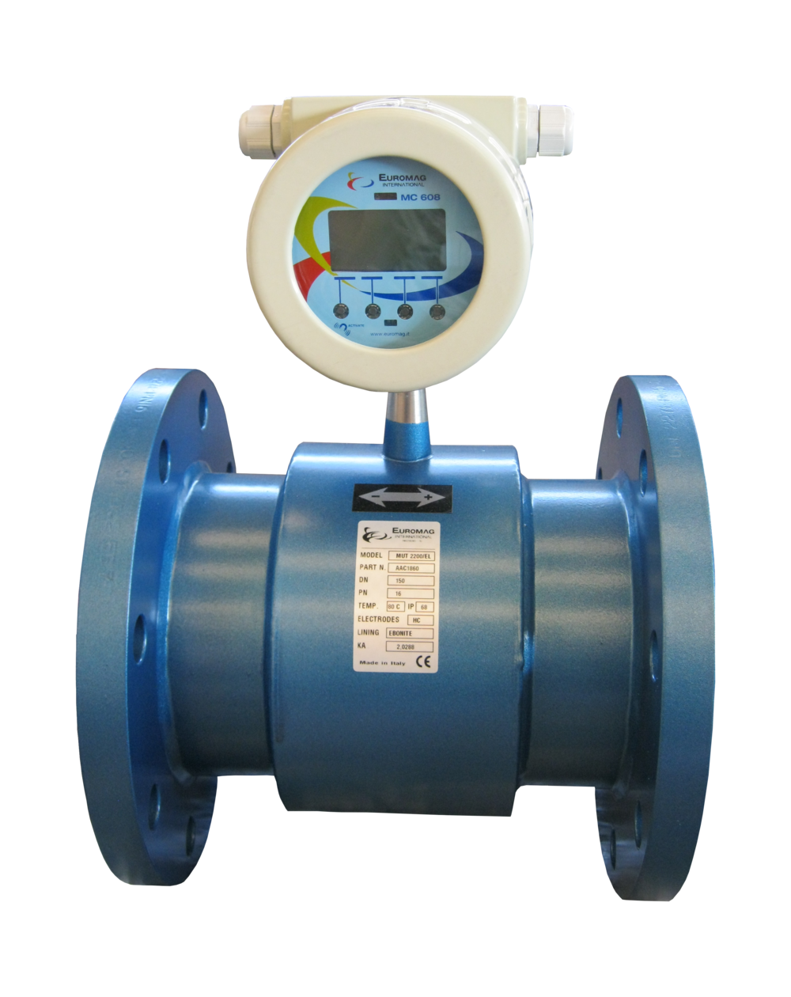
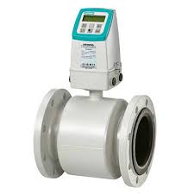
(d). Magnetic flow meter

Slide 12
2- Temperature measurement
(a). Thermometer
(b). Thermocouple
(c). Thermal Resistance meter
(d). Filled –bulb Temperature sensor

Slide 13
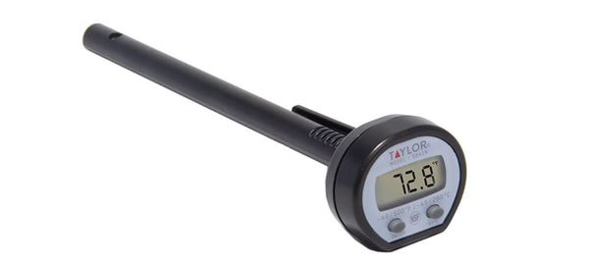
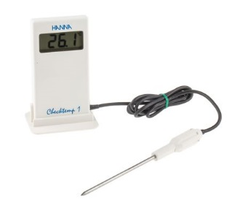
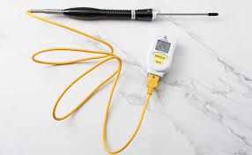
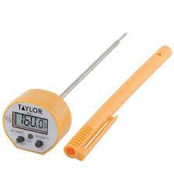
(a). Thermometer

Slide 14
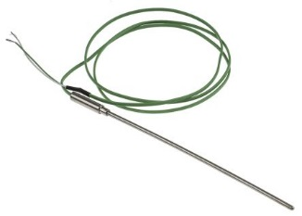
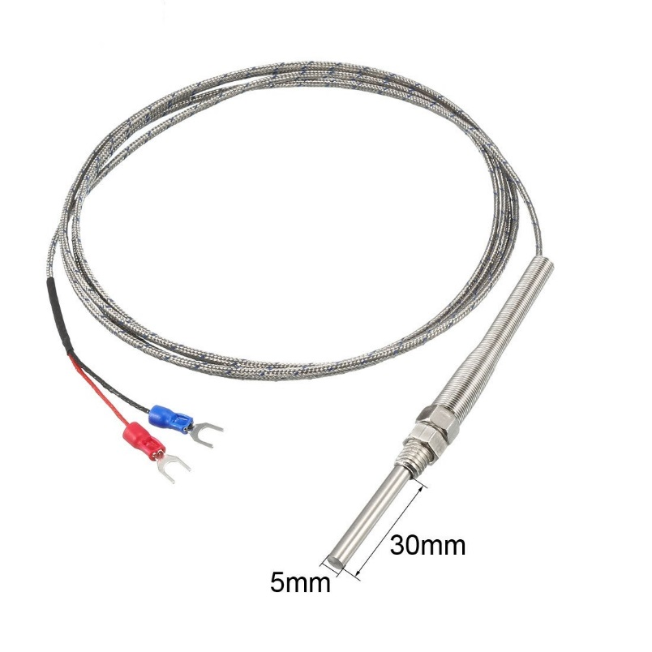
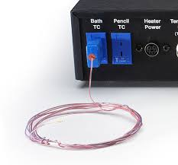
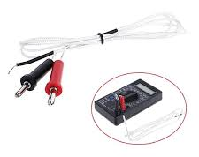
(b). Thermocouple

Slide 15
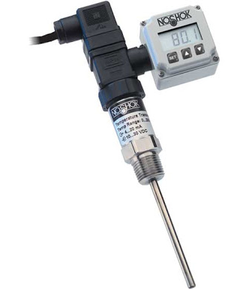
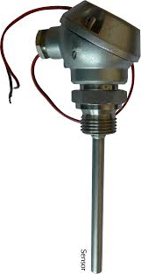
(c). Thermal Resistance meter

Slide 16
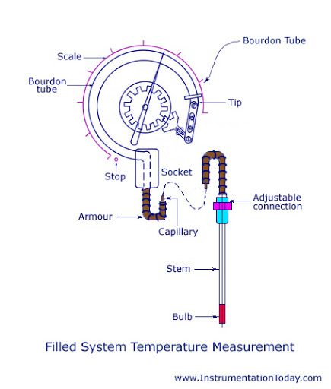
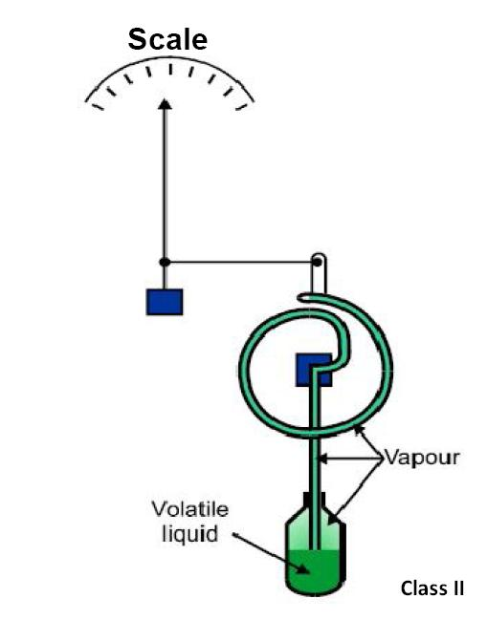
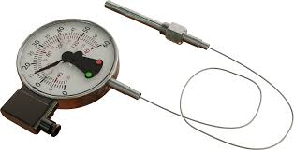
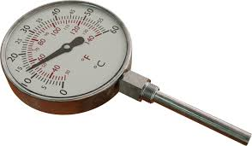
(d). Filled –bulb Temperature sensor

Slide 17
3- Pressure measurement
(a). Bellows
(b). Bourdon tube
(c). Diaphragm
(d). Strain gage

Slide 18
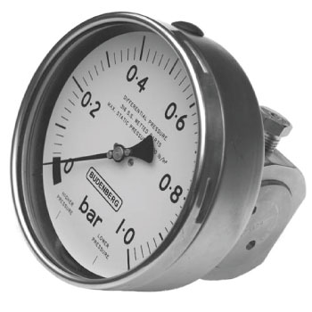
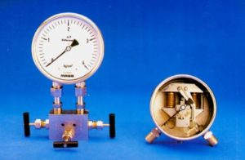
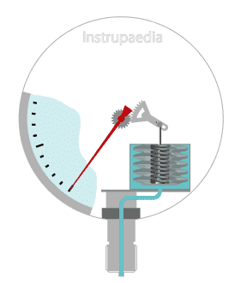
(a). Bellows

Slide 19
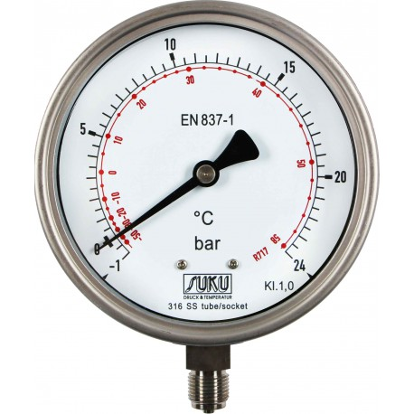
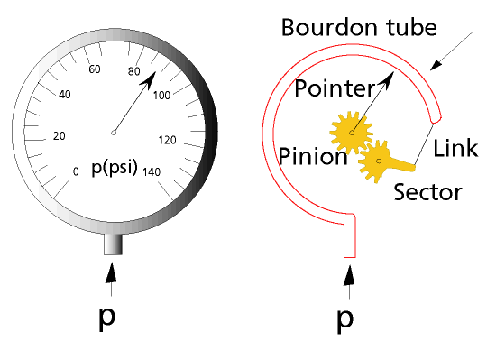
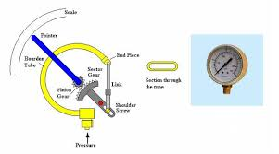
(b). Bourdon tube

Slide 20
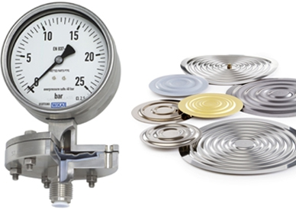
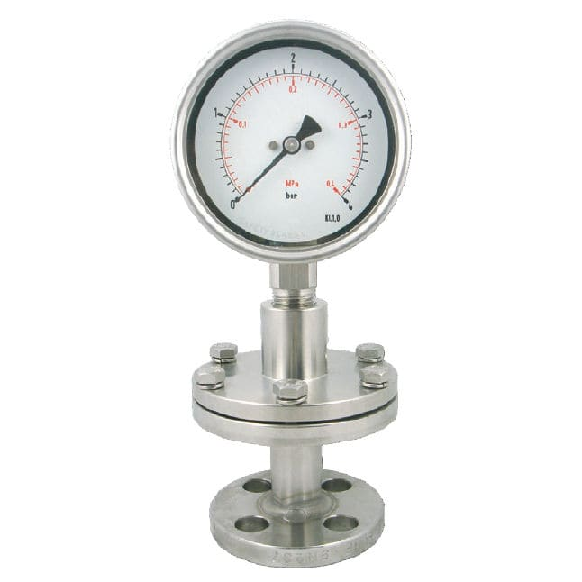
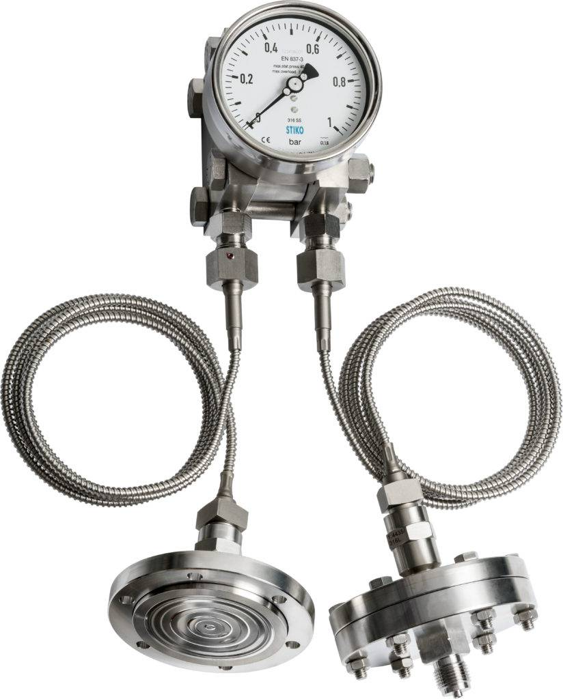
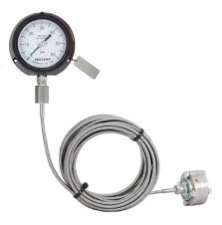
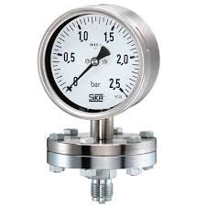
(c). Diaphragm

Slide 21
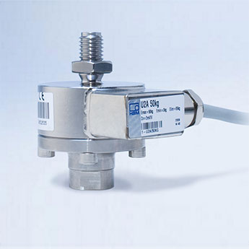
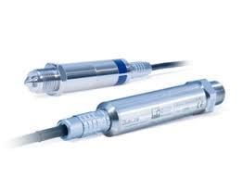
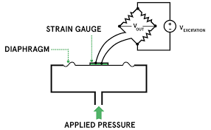
(d). Strain gage

Slide 22
4- Level measurement
Float
Sight
Capacitance
Weight
Ultrasonic
Waves(radar)

Slide 23
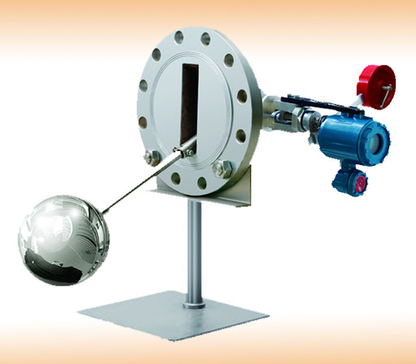
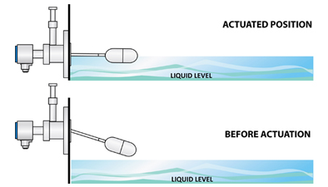
Float

Slide 24
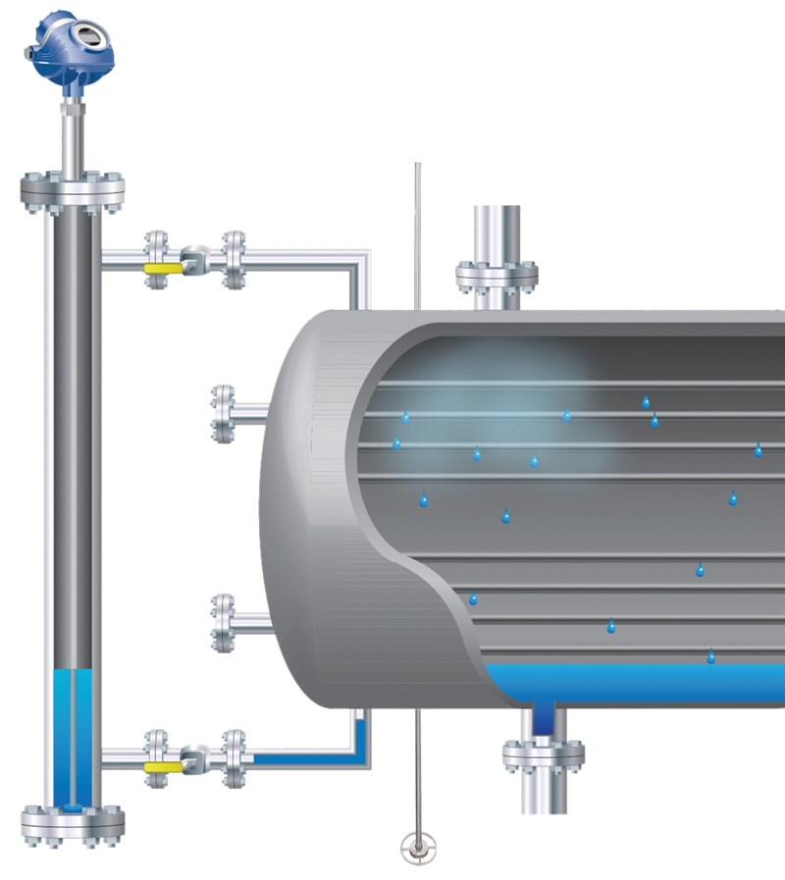
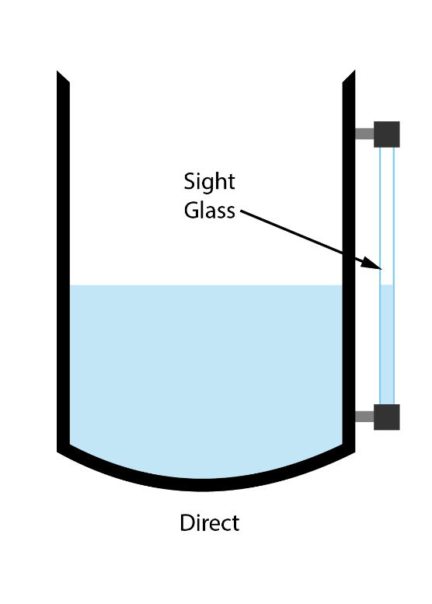
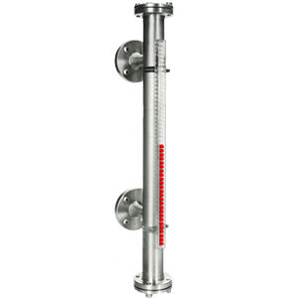
b. Sight

Slide 25
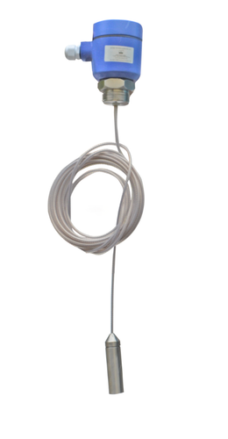
c. Capacitance

Slide 26
(d). Weight

Slide 27
(e). Ultrasonic

Slide 28
(f). Waves(Radar)

Slide 29
5- Concentration measurement
Conductivity meter
Density meter

Slide 30
Conductivity meter

Slide 31
(b).Density meter

Slide 32
Function performed by the instrumentation
Symbol | Action | Example | description
A | Alarm |  | Pressure Alarm
C | Control |  | Pressure control
I | Indicator |  | Level Indicator
R | Recorder |  | Flow recorder
T | Transmitter |  | Level Transmitter
PA
PC
LI
FR
LT

Slide 33
Notes about signal flow block diagram
$$\frac{ 1}{2s+1}$$
$xi$(s)
+
+
$E$(s)
+
$ysp$(s)
$$\frac{ 1}{2s+1}$$
∑
$$Gc$$
$$Gv$$
∑
$y$(s)
_
$ym$(s)
$$Gm$$
$xi$(s)
+
$E$(s)
$ysp$(s)
$$\frac{ 1}{2s+1}$$
∑
$$Gc$$
$$Gv$$
∑
$y$(s)
_
$ym$(s)
$$Gm$$

Slide 34
$xi$(s)
$$\frac{ 1}{2s+1}$$
+
+
$E$(s)
+
$ysp$(s)
$$\frac{ 2}{2s+1}$$
∑
$$Gc$$
$$Gv$$
∑
$y$(s)
_
$ym$(s)
$$Gm$$
$xi$(s)
$$1/2$$
+
$E$(s)
$ysp$(s)
$$\frac{ 2}{2s+1}$$
∑
$$Gc$$
$$Gv$$
∑
$y$(s)
_
$ym$(s)
$$Gm$$

Slide 35
$xi$(s)
$$\frac{ 3}{2s+1}$$
+
+
$E$(s)
+
$ysp$(s)
$$\frac{ 4}{2s+1}$$
∑
$$Gc$$
$$Gv$$
∑
$y$(s)
_
$ym$(s)
$$Gm$$
$xi$(s)
$$?$$
+
$E$(s)
$ysp$(s)
$$\frac{4}{2s+1}$$
∑
$$Gc$$
$$Gv$$
∑
$y$(s)
_
$ym$(s)
Ans.: 3/4
$$Gm$$

Slide 36
+
+
Σ
+
+
-
-

Slide 37
Thank you for your listening
Any ?

